Slide 1
Covid-19, Short-term rent registrations & Venues Data Analysis of Toronto city
Souhail Berdaa
March 29, 2021

Slide 2

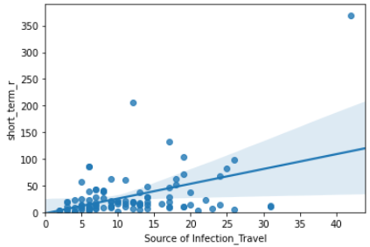
Relationship between Source of infection and short-term rental registrations
The Pearson correlation coefficient is 0.43 between these two variables with a p- value less than 0.001.
Conclusion:
Since the p-value is <0.001, the correlation between source of infections_travel and short-term rental registrations is statistically significant, but the linear relationship is only moderate (~0.43).

Slide 3

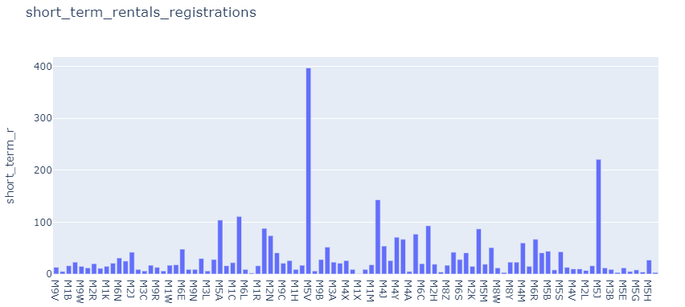
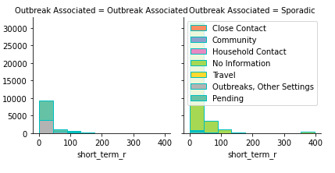

Short term rental registrations distribution in each Postal code

Slide 4
Observations
M5V Have the highest number of short-term rent registrations
M5V is located next to the Airport in Centre island.

Slide 5
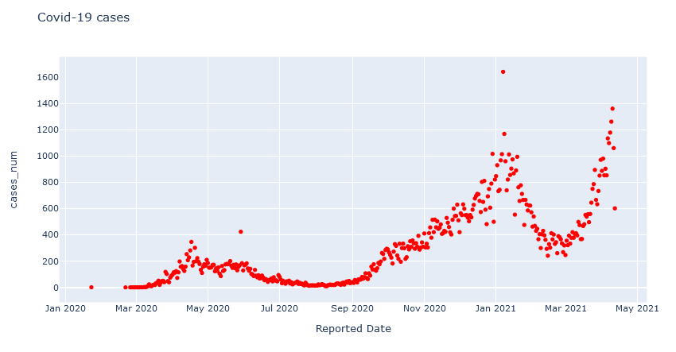
Third Wave

Slide 6
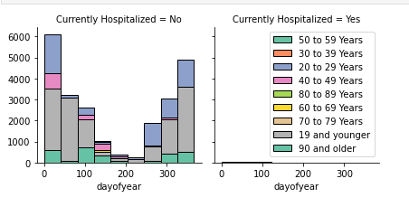
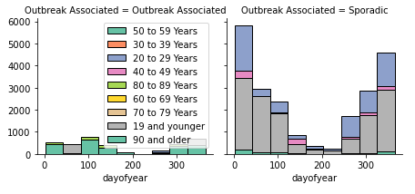
Outbreak associated and hospitalizations age group population analysis

Slide 7
Toronto neighborhood clustering(Machine Learning)
K-means clustering was used to cluster neighborhoods in 3 distinct groups.
Elbow method was used to determine the optimal K.

Slide 8
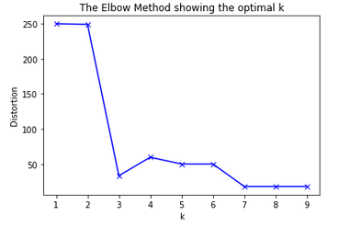
Optimal K K=3

Slide 9
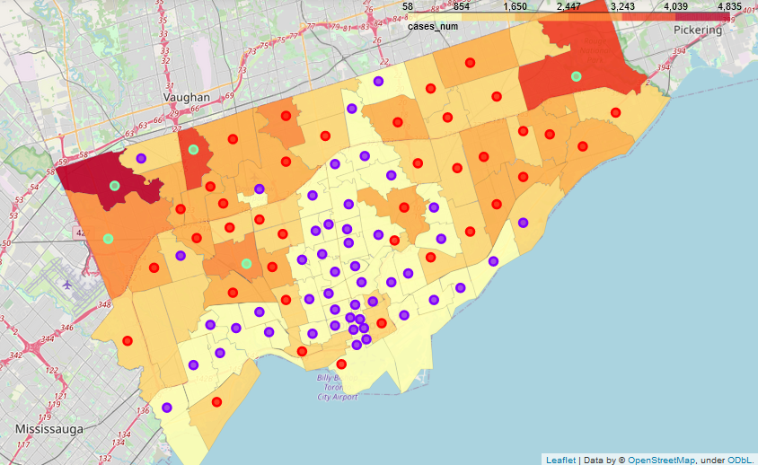
Results

Slide 10
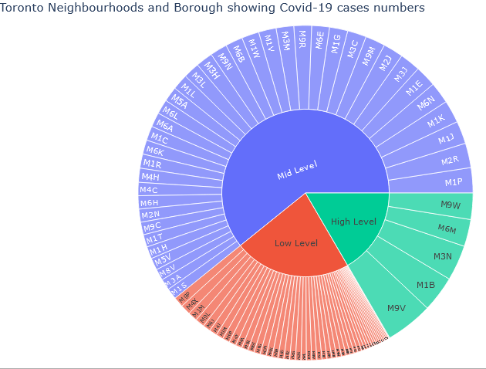
Toronto city clusters and their postal codes

Slide 11
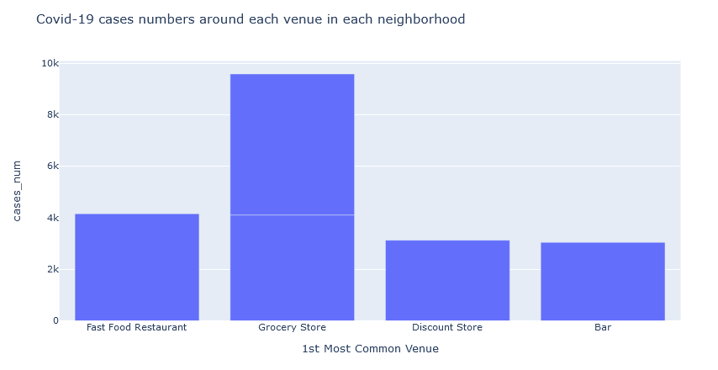
Most Venues and number of cases around each one

Slide 12
Conclusion
Population density is higher in low level cluster which means there is less COVID-19 community infections and more people to attract if you are willing to open a business
Low Clusters and mid-level cluster have diverse venues so that could mean more competitive market for some businesses.
Low Clusters and mid-level clusters have Less risk of having a Covid-19 outbreak related in your business.
To avoid: high level cluster (Etobicoke and Scarborough, Malvern rouge) where high number of Covid-19 is observed knowing that this neighborhood has less population density than other city’s neighborhoods.

